Slide 1
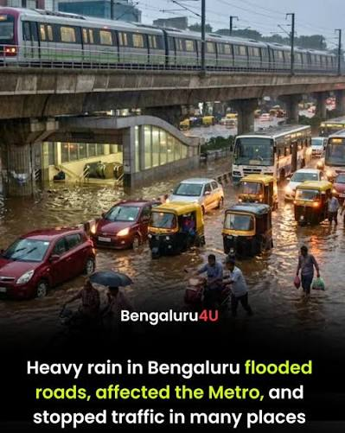
Smart Drain Flood Monitoring System
A Real-Time IoT-Based Early Warning System
Aditya Mathad
Christo Savio George
Sandeep A Patil
Vivek Patne M
1RN24EC008
1RN24CD019
1RN24EC117
1RN24CD112
Presented by:

Slide 2

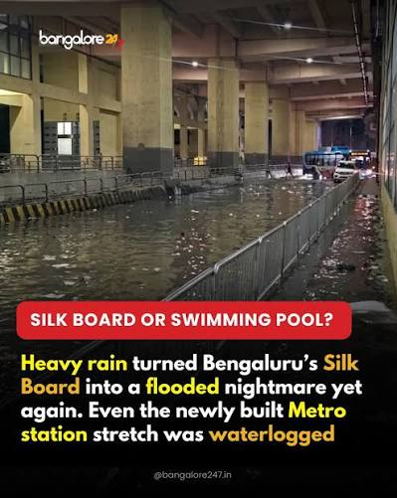
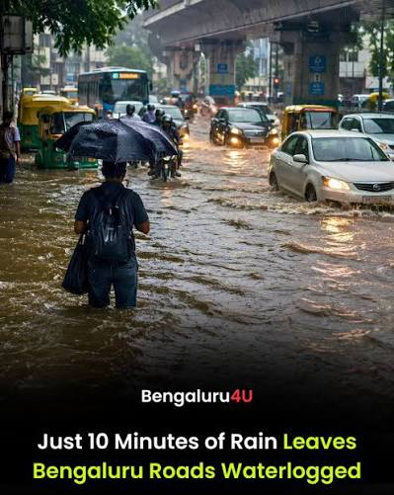
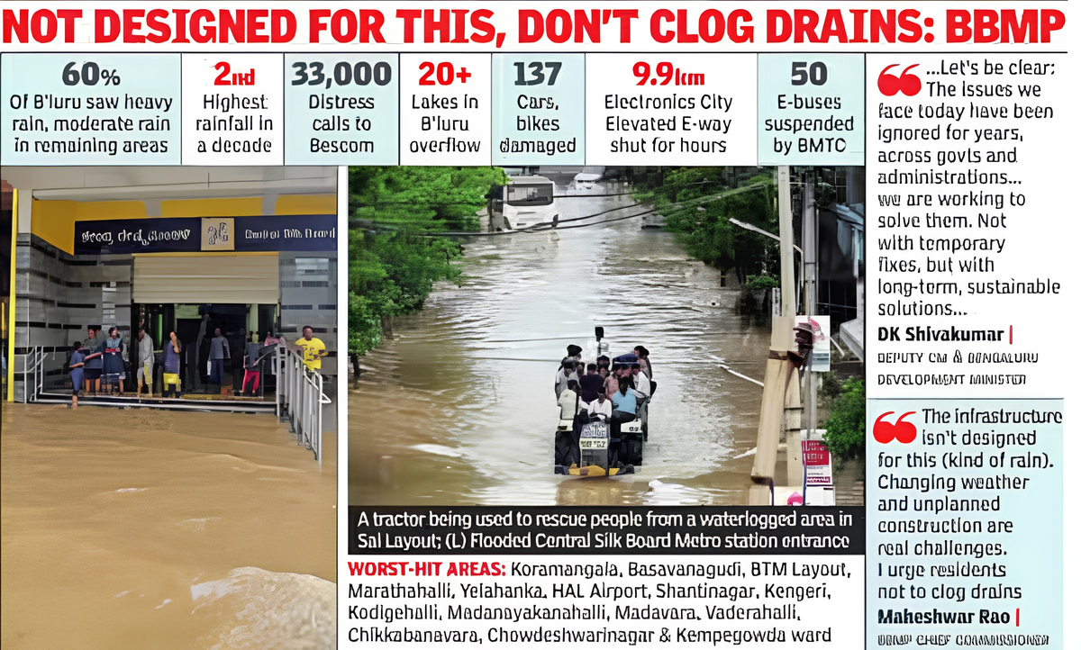
THE PROBLEM
Heavy Rain, Flooded Roads, No Warning
  A few hours of heavy rain is enough to flood roads, drains, and low-lying areas across the city.
  Waterlogging disrupts traffic, damages homes and vehicles, and puts lives at risk every monsoon.
  Drains are usually checked only after flooding has already happened.
  Citizens have no easy way to warn each other or alert authorities in real time.
Smart Flood Monitoring
02

Slide 3




OUR SOLUTION
Intelligent Water Clogging and Flood
Prevention Using Real-Time Data
A smart early-warning system that watches water levels as they rise, predicts flooding before it happens, and alerts people in time to act.
Real-Time Monitoring
Early Prediction
Water levels are tracked continuously, with no manual checking needed.
Live readings plus weather forecasts flag rising risk before it turns critical.
Instant Alerts
Citizen Reporting
Alerts reach a live dashboard, on-site lights, and email the moment risk rises.
Anyone nearby can report waterlogging straight from their phone.
Smart Flood Monitoring
03

Slide 4





RESULTS & IMPACT
What We Built — and Why It's Worth Adopting
What We Achieved
Why It's Worth Adopting
Tracks water levels and classifies risk into clear stages - Normal, Watch, Alert, Critical.
Faster Response
Know before the road is already flooded, not after.
Sends alerts well before water reaches a dangerous level, giving real time to react.
Safer for Everyone
Fewer surprises for commuters, property, and response teams.
A live dashboard shows current status, trends, and history at a glance.
Built to Scale
Grows from one drain to an entire city without a redesign.
A citizen-reporting channel is live and tested end-to-end.
Fits Civic Priorities
Low-cost and data-backed — easy to plug into control rooms.
Smart Flood Monitoring
04

Slide 5







TECHNOLOGY
How It Works Under the Hood
Real-Time Monitoring
Data Management
Prevention & Control
Field data is collected and refreshed continuously.
Readings are cleaned, smoothed, and turned into a clear risk status.
Automated alerts and controls act before flooding escalates.
BUILT WITH
ESP32 + HC SR04 + Float Switch
MQTT Messaging
Node-RED
Weather Data (OpenWeatherMap)
Node-RED Dashboard
Email Alerts
Smart Flood Monitoring
05

Slide 6




WHAT'S NEXT
Where We're Taking This Next
Blockage Detection
Automated Pump / Valve Control
City-Wide Scaling
Spot clogged drains so maintenance teams know exactly where to act.
Trigger drainage pumps or valves automatically in high-risk moments.
Expand from one point to multiple zones, all on one dashboard.
Mobile App & SMS Alerts
Municipal Integration
Reach citizens directly on their phones, even without internet.
Connect into government control rooms and disaster-management systems.
Smart Flood Monitoring
06

